Slide 1
Data Analytics (CS3203N)
Lecture #6
Sampling Distributions

Slide 2

Quote of the day..
A fool thinks himself a wise, a wise thinks that he is a fool.
Unknown

Slide 3
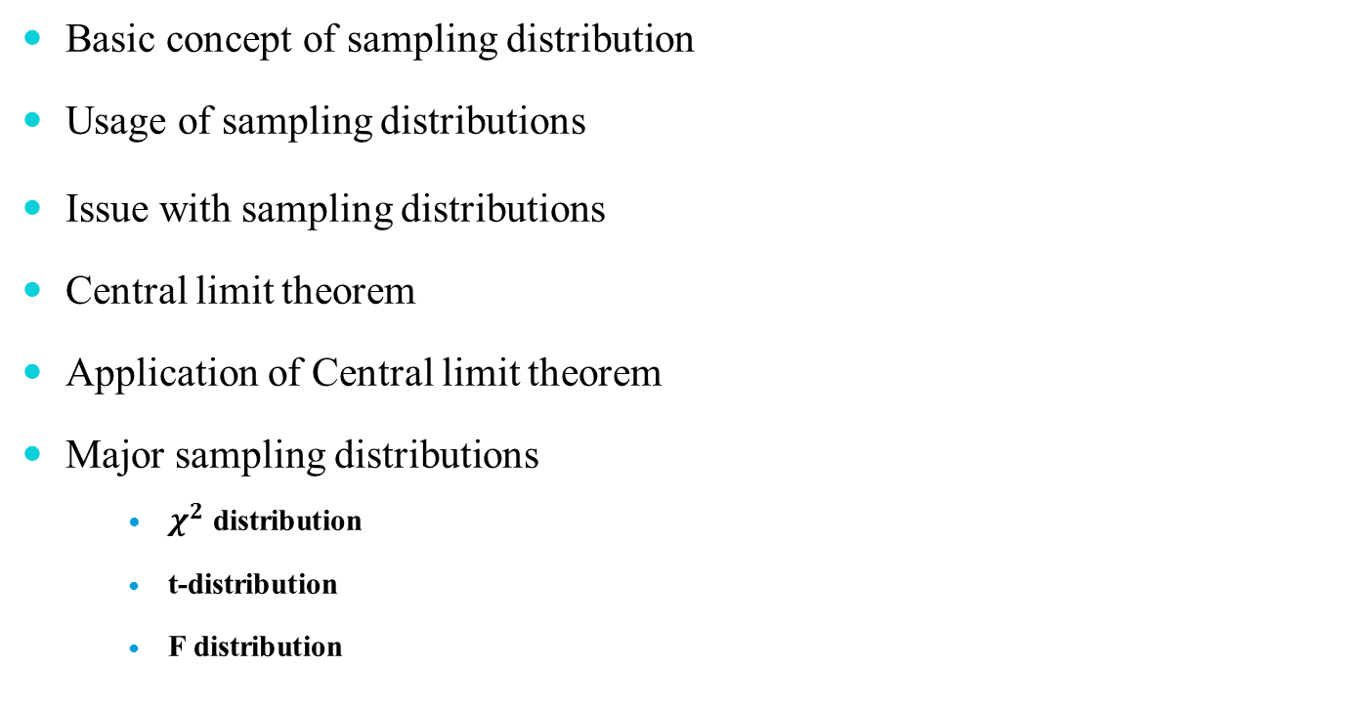
In this presentation…
Basic concept of sampling distribution
Usage of sampling distributions
Issue with sampling distributions
Central limit theorem
Application of Central limit theorem
Major sampling distributions
$χ^{2}$ distribution
t-distribution
F distribution

Slide 4
Introduction
As a task of statistical inference, we usually follow the following steps:
Data collection
Collect a sample from the population.
Statistics
Compute a statistics from the sample.
Statistical inference
From the statistics we made various statements concerning the values of population parameters.
For example, population mean from the sample mean, etc.

Slide 5
Basic terminologies
Some basic terminology which are closely associated to the above-mentioned tasks are reproduced below.
Population: A population consists of the totality of the observation, with which we are concerned.
Sample: A sample is a subset of a population.
Random variable: A random variable is a function that associates a real number with each element in the sample.
Statistics: Any function of the random variable constituting random sample is called a statistics.
Statistical inference: It is an analysis basically concerned with generalization and prediction.

Slide 6
Statistical Inference
There are two facts, which are key to statistical inference.
Population parameters are fixed number whose values are usually unknown.
Sample statistics are known values for any given sample, but vary from sample to sample, even taken from the same population.
In fact, it is unlikely for any two samples drawn independently, producing identical values of sample statistics.
In other words, the variability of sample statistics is always present and must be accounted for in any inferential procedure.
This variability is called sampling variation.
Note:
A sample statistics is random variable and like any other random variable, a sample statistics has a probability distribution.
Why probability distribution for random variable is not applicable to sample statistics?

Slide 7
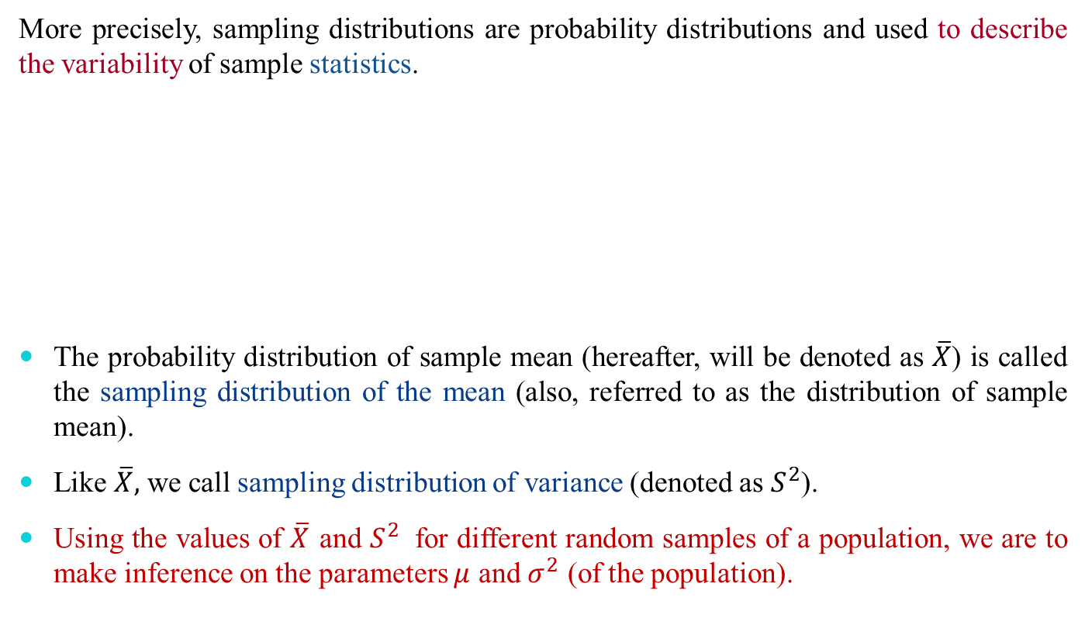
Sampling Distribution
More precisely, sampling distributions are probability distributions and used to describe the variability of sample statistics.
The probability distribution of sample mean (hereafter, will be denoted as $\overline{X}$) is called the sampling distribution of the mean (also, referred to as the distribution of sample mean).
Like $\overline{X},$ we call sampling distribution of variance (denoted as $S^{2}$).
Using the values of ${\overline{X}}_{ }$and ${S^{2}}_{ }$ for different random samples of a population, we are to make inference on the parameters $μ$ and $σ^{2}$ (of the population).
Definition 5.1: Sampling distribution
The sampling distribution of a statistics is the probability distribution of that statistics.

Slide 8
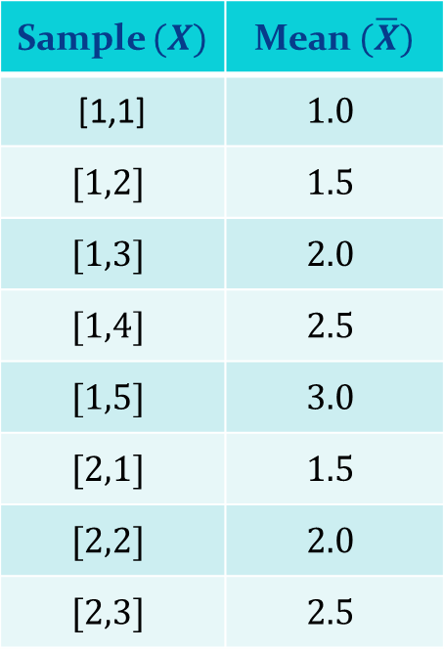
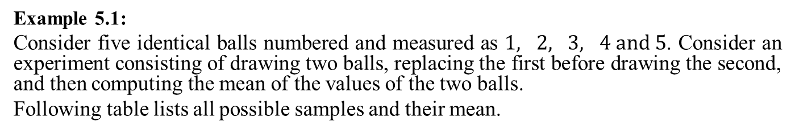
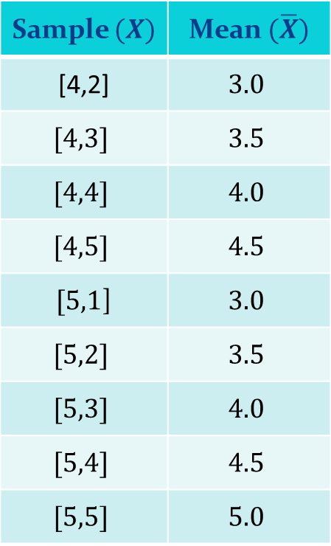
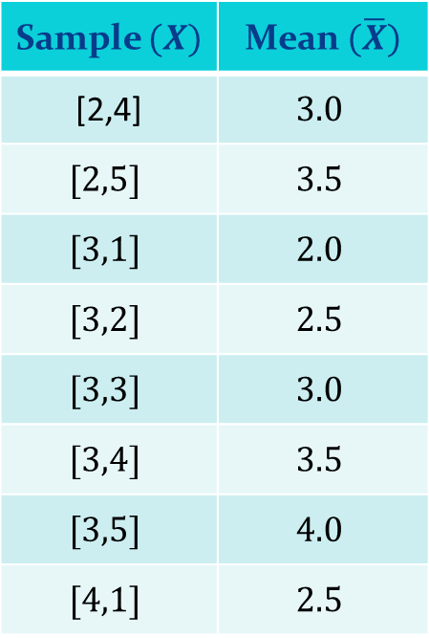
Sampling Distribution
Example 5.1:
Consider five identical balls numbered and measured as $1, 2, 3, 4 and 5$. Consider an experiment consisting of drawing two balls, replacing the first before drawing the second, and then computing the mean of the values of the two balls.
Following table lists all possible samples and their mean.
Sample $(X)$ | Mean $(\overline{X})$
[1,1] | $$1.0$$
$$[1,2]$$ | $$1.5$$
$$[1,3]$$ | $$2.0$$
$$[1,4]$$ | $$2.5$$
$$[1,5]$$ | $$3.0$$
$$[2,1]$$ | $$1.5$$
$$[2,2]$$ | $$2.0$$
$$[2,3]$$ | $$2.5$$
Sample $(X)$ | Mean $(\overline{X})$
[2,4] | $$3.0$$
$$[2,5]$$ | $$3.5$$
$$[3,1]$$ | $$2.0$$
$$[3,2]$$ | $$2.5$$
$$[3,3]$$ | $$3.0$$
$$[3,4]$$ | $$3.5$$
$$[3,5]$$ | $$4.0$$
$$[4,1]$$ | $$2.5$$
Sample $(X)$ | Mean $(\overline{X})$
[4,2] | $$3.0$$
$$[4,3]$$ | $$3.5$$
$$[4,4]$$ | $$4.0$$
$$[4,5]$$ | $$4.5$$
$[5,1$] | $$3.0$$
$$[5,2]$$ | $$3.5$$
$$[5,3]$$ | $$4.0$$
$$[5,4]$$ | $$4.5$$
$$[5,5]$$ | $$5.0$$

Slide 9
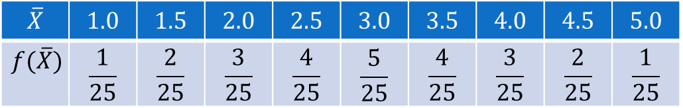
Sampling Distribution
Sampling distribution of means
$$\overline{X}$$ | $$1.0$$ | $$1.5$$ | $$2.0$$ | $$2.5$$ | $$3.0$$ | $$3.5$$ | $$4.0$$ | $$4.5$$ | $$5.0$$
$$f(\overline{X})$$ | $$\frac{1}{25}$$ | $$\frac{2}{25}$$ | $$\frac{3}{25}$$ | $$\frac{4}{25}$$ | $$\frac{5}{25}$$ | $$\frac{4}{25}$$ | $$\frac{3}{25}$$ | $$\frac{2}{25}$$ | $$\frac{1}{25}$$

Slide 10
Issues with Sampling Distribution
In practical situation, for a large population, it is infeasible to have all possible samples and hence probability distribution of sample statistics.
The sampling distribution of a statistics depends on
the size of the population
the size of the samples and
the method of choosing the samples.
?

Slide 11
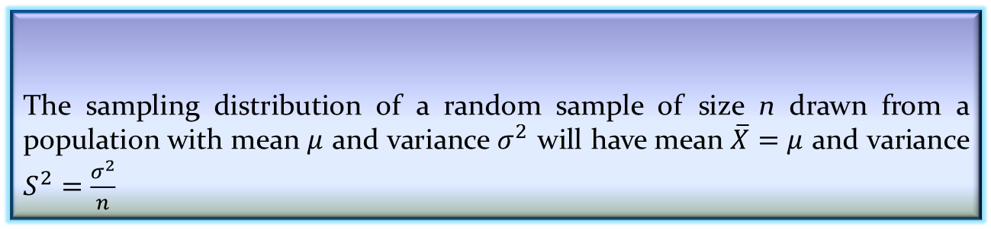

Theorem on Sampling Distribution
Famous theorem in Statistics
Example: The two balls experiment obeys the theorem.
Example 5.2: With reference to data in Example 5.1
For the population, $μ=\frac{1+2+3+4+5}{5}=3$
$σ^{2}=\frac{10}{5}=2$
Applying the theorem, we have $\overline{X}=3 and S^{2}=1$
Hence, the theorem is verified!
The sampling distribution of a random sample of size n drawn from a population with mean $μ$ and variance $σ^{2}$ will have mean $\overline{X}=μ$ and variance $S^{2}=\frac{σ^{2}}{n}$
Theorem 5.1: Sampling distribution of mean and variance

Slide 12
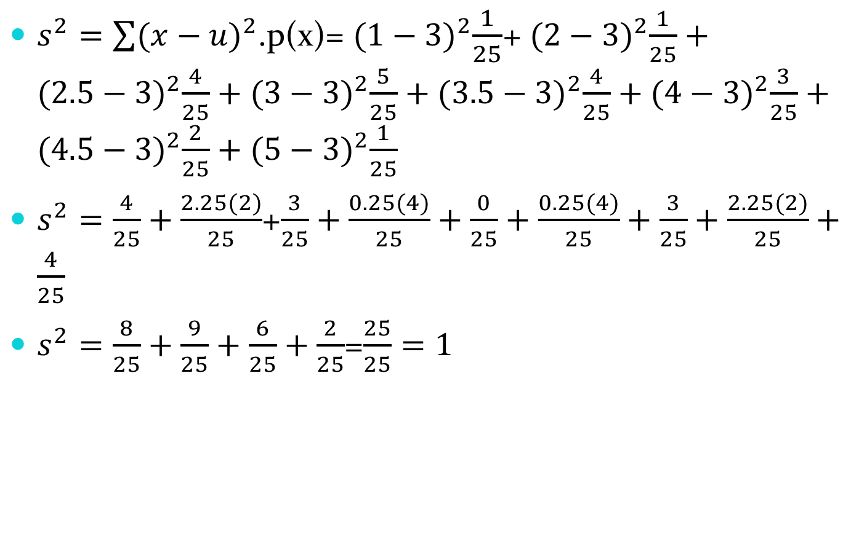
$s^{2}=\sum{{(x−u)}^{2}}$.p(x)= ${(1−3)}^{2}\frac{1}{25}$+ ${(2−3)}^{2}\frac{1}{25}+{(2.5−3)}^{2}\frac{4}{25}+{(3−3)}^{2}\frac{5}{25}+{(3.5−3)}^{2}\frac{4}{25}+{(4−3)}^{2}\frac{3}{25}+{(4.5−3)}^{2}\frac{2}{25}+{(5−3)}^{2}\frac{1}{25}$
$s^{2}=\frac{4}{25}+\frac{2.25(2)}{25}$+$\frac{3}{25}+\frac{0.25(4)}{25}+\frac{0}{25}+\frac{0.25(4)}{25}+\frac{3}{25}+\frac{2.25(2)}{25}+\frac{4}{25}$
$s^{2}=\frac{8}{25}+\frac{9}{25}+\frac{6}{25}+\frac{2}{25}$=$\frac{25}{25}=1$

Slide 13
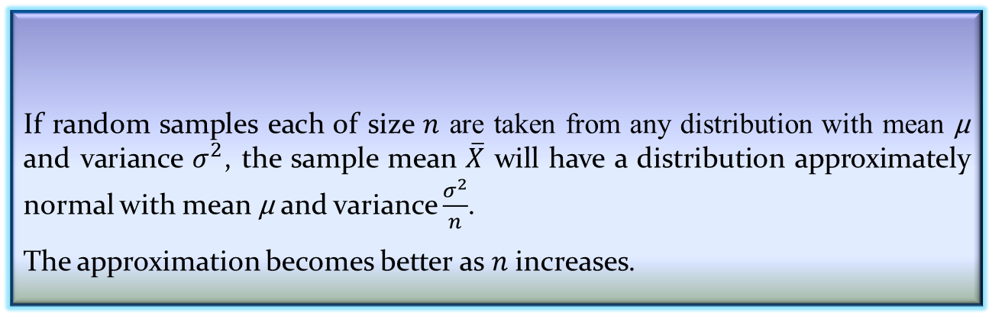

Central Limit Theorem
The Theorem 5.1 is an amazing result and in fact, also verified that if we sampling from a population with unknown distribution, the sampling distribution of $\overline{X}$ will still be approximately normal with mean $\text{μ}$ and variance $\frac{σ^{2}}{n}$ provided that the sample size is large.
This further, can be established with the famous “central limit theorem”, which is stated below.
If random samples each of size $n$ are taken from any distribution with mean $\text{μ}$ and variance $σ^{2}$, the sample mean $\overline{X}$ will have a distribution approximately normal with mean $\text{μ}$ and variance $\frac{σ^{2}}{n}$.
The approximation becomes better as $n$ increases.
Theorem 5.3: Central Limit Theorem

Slide 14
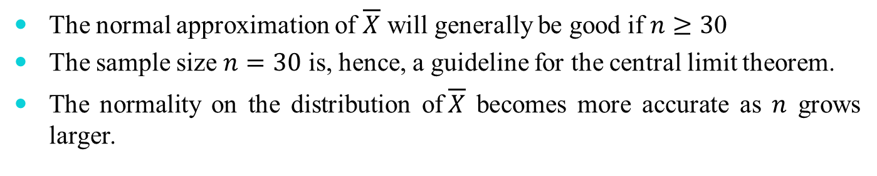
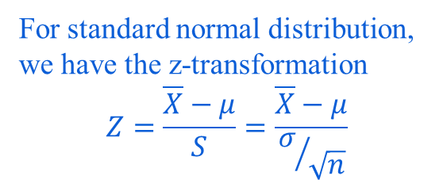
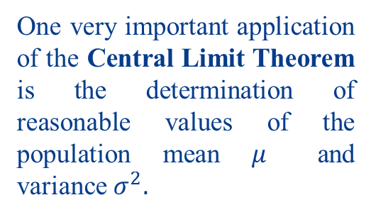
Applicability of Central Limit Theorem
The normal approximation of $\overline{X}$ will generally be good if $n≥3$0
The sample size $n=30$ is, hence, a guideline for the central limit theorem.
The normality on the distribution of$\overline{X}$ becomes more accurate as $n$ grows larger.
One very important application of the Central Limit Theorem is the determination of reasonable values of the population mean $μ$ and variance $σ^{2}.$
For standard normal distribution, we have the z-transformation
$$Z=\frac{\overline{X}−μ}{S}=\frac{\overline{X}−μ}{σ/{\sqrt{n}}}$$

Slide 15
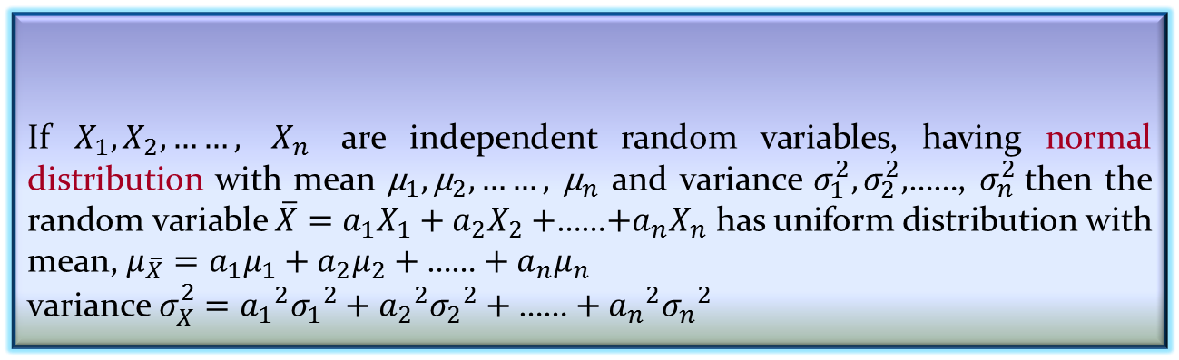
Extension
If $X_{1},X_{2},……,$ $X_{n}$ are independent random variables, having normal distribution with mean ${\text{μ}}_{1},{\text{μ}}_{2},……,$ ${\text{μ}}_{n}$ and variance $σ_{1}^{2},σ_{2}^{2},$……, $σ_{n}^{2}$then the random variable $\overline{X}=a_{1}X_{1}+a_{2}X_{2}+$……$+a_{n}X_{n}$ has uniform distribution with mean, $μ_{\overline{X}}=a_{1}μ_{1}+a_{2}μ_{2}+\text{……}+a_{n}μ_{n}$
variance${ σ}_{\overline{X}}^{2} ={a_{1}}^{2}{σ_{1}}^{2}+{a_{2}}^{2}{σ_{2}}^{2}+\text{……}+{a_{n}}^{2}{σ_{n}}^{2}$
Theorem 5.2: Reproductive property of normal distribution
Note:
If all samples $X_{1},X_{2},……,$ $X_{n}$ are uniformly distributed then $a_{1}=a_{2}=…$= $\frac{1}{n}$

Slide 16
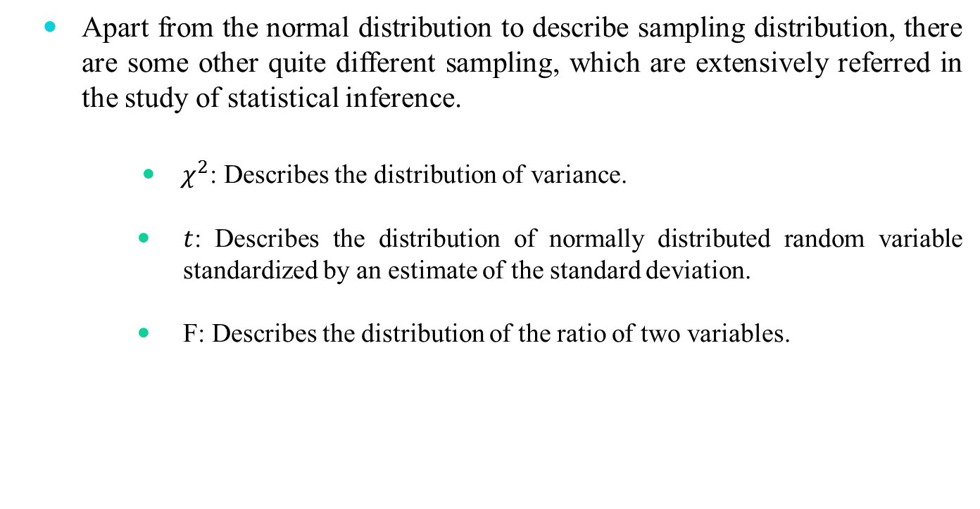
Standard Sampling Distributions
Apart from the normal distribution to describe sampling distribution, there are some other quite different sampling, which are extensively referred in the study of statistical inference.
$χ^{2}$: Describes the distribution of variance.
$t$: Describes the distribution of normally distributed random variable standardized by an estimate of the standard deviation.
F: Describes the distribution of the ratio of two variables.

Slide 17

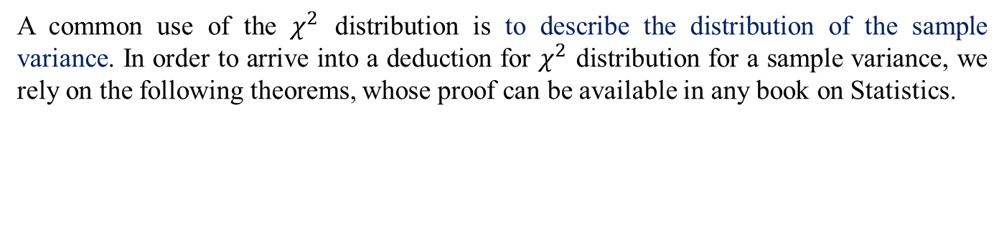
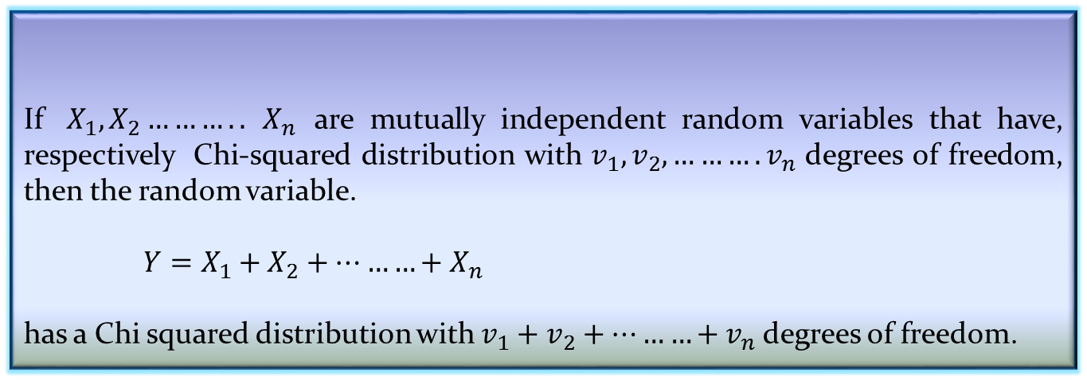
The $χ^{2}$ Distribution
A common use of the $χ^{2}$ distribution is to describe the distribution of the sample variance. In order to arrive into a deduction for $χ^{2}$ distribution for a sample variance, we rely on the following theorems, whose proof can be available in any book on Statistics.
Theorem 5.4: Linear combination of random variable
If $X_{1},X_{2}………..$ $X_{n}$ are mutually independent random variables that have, respectively Chi-squared distribution with $v_{1},v_{2},……….v_{n}$ degrees of freedom, then the random variable.
$Y=X_{1}+X_{2}+………+X_{n}$
has a Chi squared distribution with $v_{1}+v_{2}+………+v_{n}$ degrees of freedom.

Slide 18
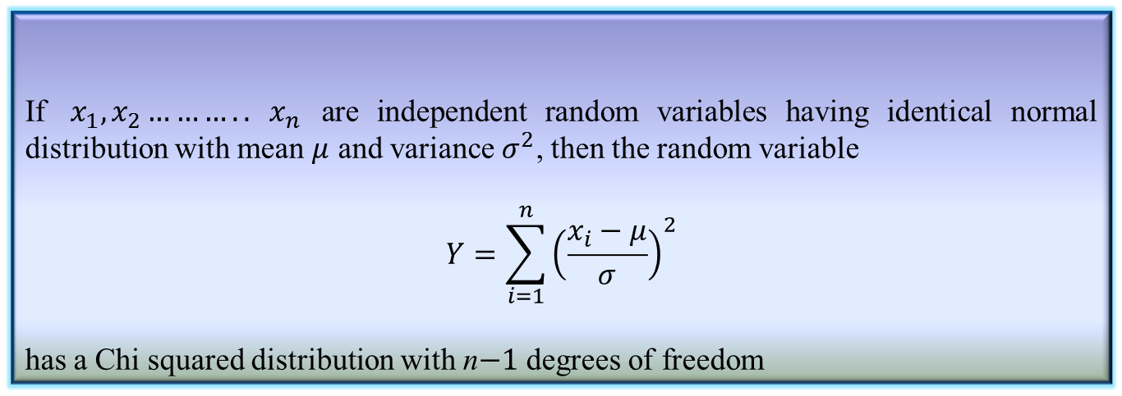
The $χ^{2}$ Distribution
An important corollary of the Theorem 5.4 is stated below.
Corollary 5.1: Reference Theorem 5.4
If $x_{1},x_{2}………..$ $x_{n}$ are independent random variables having identical normal distribution with mean $μ$ and variance$σ^{2}$, then the random variable
$$Y=\sum_{i=1}^{n}{{\left(\frac{x_{i}−μ}{σ}\right)}^{2}}$$
has a Chi squared distribution with n$−1$ degrees of freedom

Slide 19
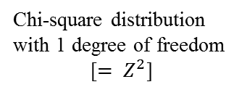
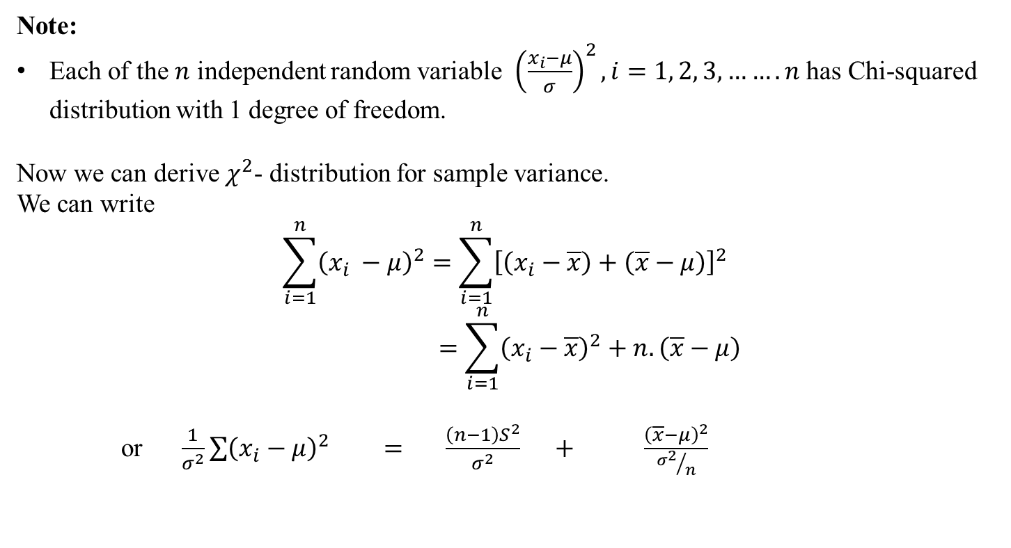

The $χ^{2}$ Distribution
Note:
Each of the $n$ independent random variable ${\left(\frac{x_{i}−μ}{σ}\right)}^{2},i=1, 2, 3,…….n$ has Chi-squared distribution with 1 degree of freedom.
Now we can derive $χ^{2}$- distribution for sample variance.
We can write
$$\sum_{i=1}^{n}{{\left({x_{i}}^{ }−μ\right)}^{2}}=\sum_{i=1}^{n}{{\left[\left(x_{i}−\overline{x}\right)+\left(\overline{x}−μ\right)\right]}^{2} }$$
$$=\sum_{i=1}^{n}{{\left(x_{i}−\overline{x}\right)}^{2}+n.\left(\overline{x}−μ\right)}$$
or $\frac{1}{σ^{2}}\sum{{\left(x_{i}−μ\right)}^{2}} = \frac{\left(n−1\right)S^{2}}{σ^{2}} + \frac{{\left(\overline{x}−μ\right)}^{2}}{{σ^{2}}/n}$
Chi-square distribution with n-degree
Chi-square distribution with (n-1) degree of freedom
Chi-square distribution with 1 degree of freedom
[${= Z}^{2}$]

Slide 20
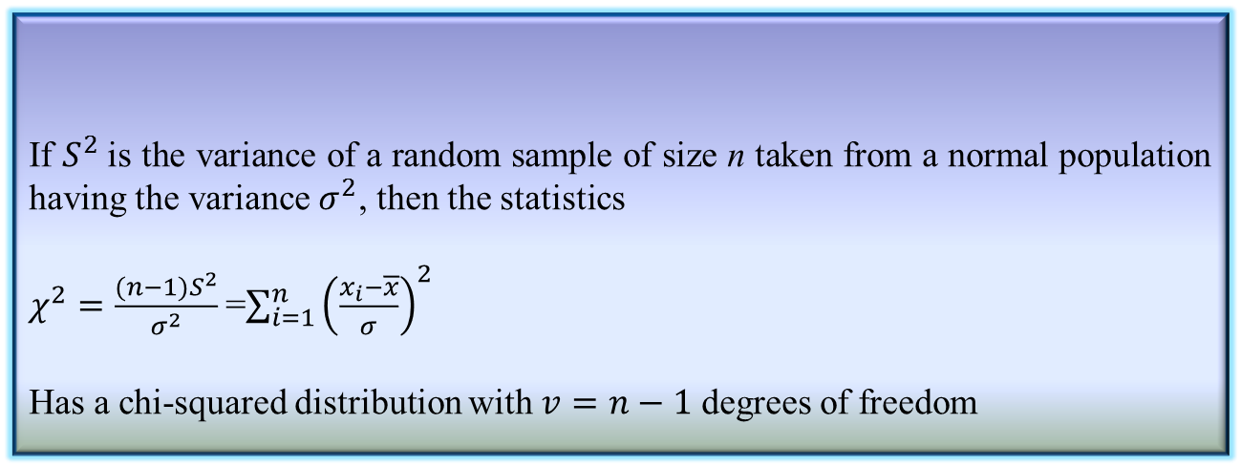
The $χ^{2}$ Distribution
Definition 5.2: $χ^{2}$-distribution for Sampling Variance
If $S^{2}$is the variance of a random sample of size n taken from a normal population having the variance $σ^{2}$, then the statistics
$χ^{2}=\frac{(n−1)S^{2}}{σ^{2}}$=$\sum_{i=1}^{n}{{\left(\frac{x_{i}−\overline{x}}{σ}\right)}^{2}}$
Has a chi-squared distribution with $v=n−1$ degrees of freedom
This way $χ^{2}$- distribution is used to describe the sampling distribution of $S^{2}$.

Slide 21
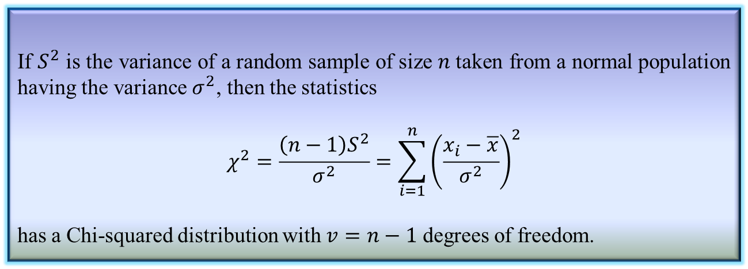
The $χ^{2}$ Distribution
Definition 5.3:${ χ}^{2}$-distribution for sampling variance
If $S^{2}$ is the variance of a random sample of size $n$taken from a normal population having the variance $σ^{2}$, then the statistics
$$χ^{2}=\frac{\left(n−1\right)S^{2}}{σ^{2}}=\sum_{i=1}^{n}{{\left(\frac{x_{i}−\overline{x}}{σ^{2}}\right)}^{2}}$$
has a Chi-squared distribution with $v=n−1$ degrees of freedom.
This way, $χ^{2}$-distribution is used to describe the sampling distribution of $S^{2}$

Slide 22
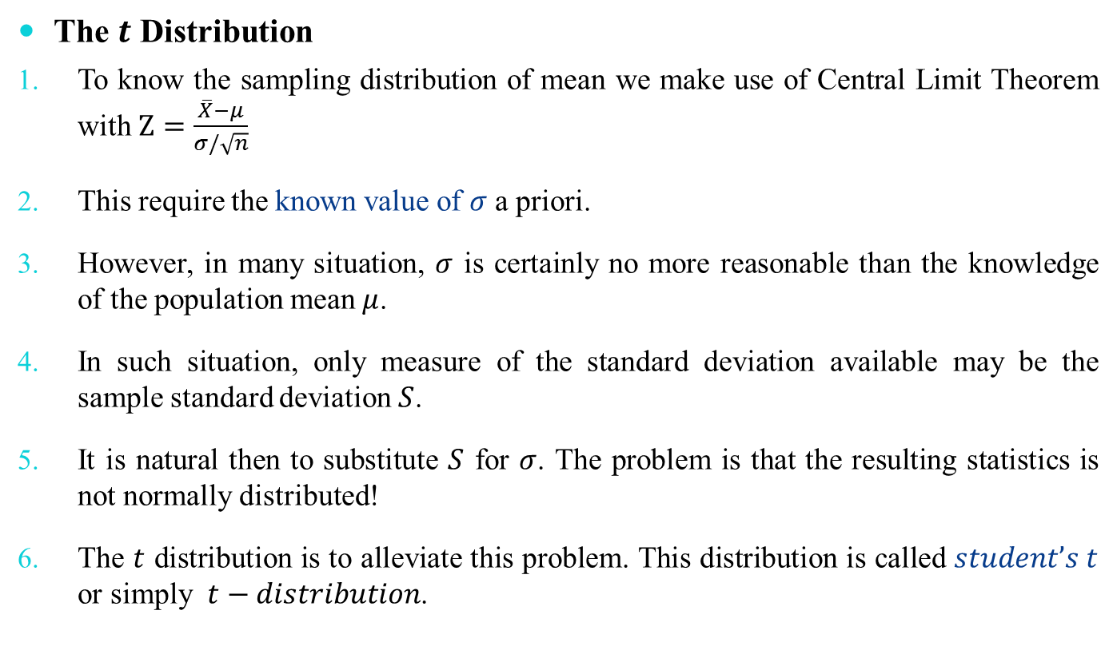
The 𝒕 Distribution
The $t$ Distribution
To know the sampling distribution of mean we make use of Central Limit Theorem with $Z=\frac{\overline{X}−μ}{σ/\sqrt{n}}$
This require the known value of $σ$ a priori.
However, in many situation, $σ$ is certainly no more reasonable than the knowledge of the population mean $μ$.
In such situation, only measure of the standard deviation available may be the sample standard deviation $S$.
It is natural then to substitute $S$ for $σ$. The problem is that the resulting statistics is not normally distributed!
The $t$ distribution is to alleviate this problem. This distribution is called $student’s t$ or simply $t−distribution$.

Slide 23
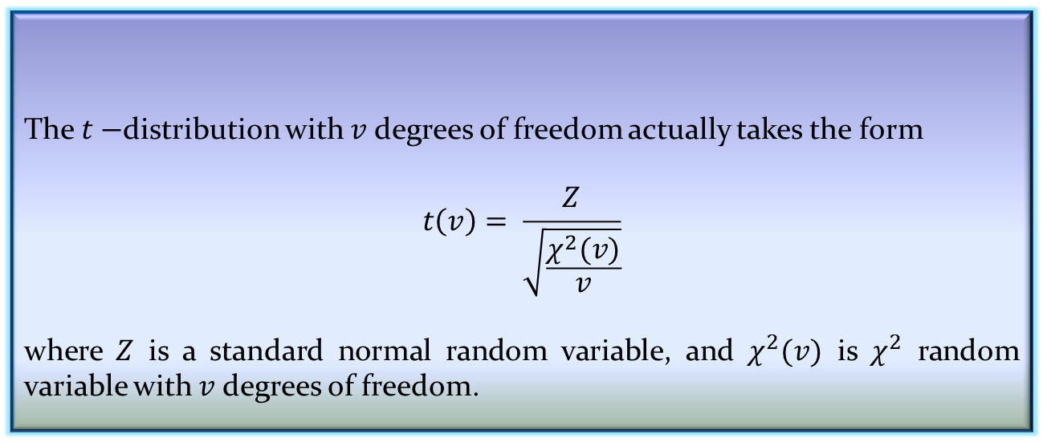

The 𝒕 Distribution
The $t$ Distribution
The $t−$distribution with $v$ degrees of freedom actually takes the form
$$t\left(v\right)= \frac{Z}{\sqrt{\frac{χ^{2}(v)}{v}}}$$
where $Z$ is a standard normal random variable, and $χ^{2}(v)$ is $χ^{2}$ random variable with $v$ degrees of freedom.
Definition 5.4: $t−$distribution

Slide 24
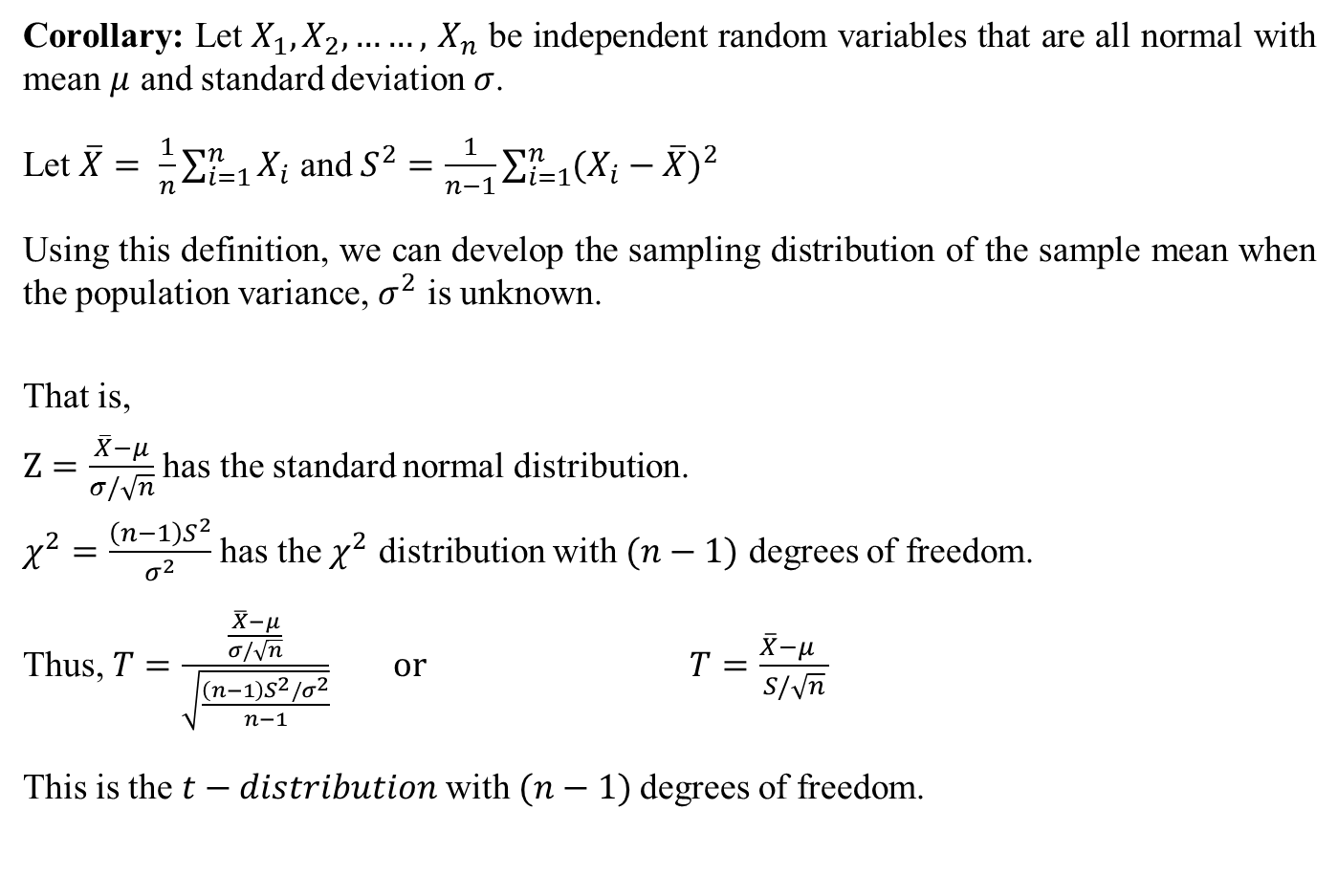
The 𝒕 Distribution
Corollary: Let $X_{1},X_{2},……,$ $X_{n}$ be independent random variables that are all normal with mean $μ$ and standard deviation $σ$.
Let $\overline{X}= \frac{1}{n}\sum_{i=1}^{n}{X_{i}}$ and $S^{2}=\frac{1}{n−1}\sum_{i=1}^{n}{{(X_{i}−\overline{X})}^{2}}$
Using this definition, we can develop the sampling distribution of the sample mean when the population variance, $σ^{2}$ is unknown.
That is,
$Z=\frac{\overline{X}−μ}{σ/\sqrt{n}}$ has the standard normal distribution.
$χ^{2}=\frac{\left(n−1\right)S^{2}}{σ^{2}}$ has the $χ^{2}$ distribution with $(n−1)$ degrees of freedom.
Thus, $T=\frac{\frac{\overline{X}−μ}{σ/\sqrt{n}}}{\sqrt{\frac{\left(n−1\right)S^{2}/σ^{2}}{n−1}}}$ $or T=\frac{\overline{X}−μ }{S/\sqrt{n}}$
This is the $t−distribution$with $(n−1)$degrees of freedom.

Slide 25


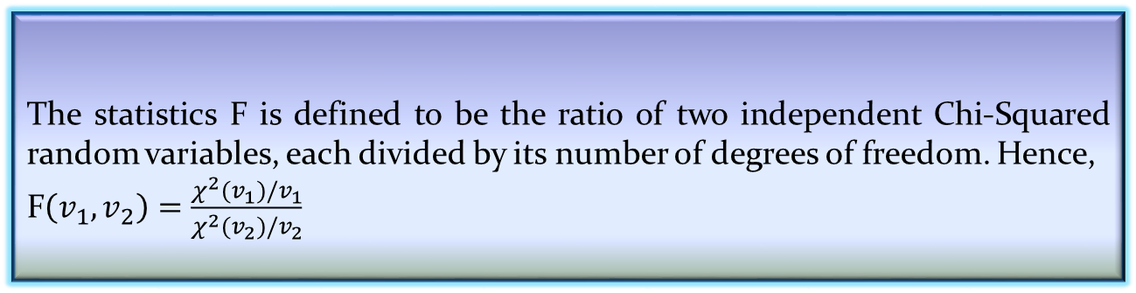
The $F$ Distribution
The $F$ distribution finds enormous applications in comparing sample variances.
Corollary: Recall that $χ^{2}=\frac{\left(n−1\right)S^{2}}{σ^{2}}$ is the Chi-squared distribution with $(n−1)$ degrees of freedom.
Therefore, if we assume that we have sample of size $n_{1}$ from a population with variance ${σ_{1}}^{2}$ and an independent sample of size $n_{2}$ from another population with variance ${σ_{2}}^{2}$, then the statistics
$$F=\frac{{S_{1}}^{2}/{σ_{1}}^{2}}{{S_{2}}^{2}/{σ_{2}}^{2}}$$
The statistics F is defined to be the ratio of two independent Chi-Squared random variables, each divided by its number of degrees of freedom. Hence,
F$\left(v_{1},v_{2}\right)=\frac{χ^{2}(v_{1})/v_{1}}{χ^{2}(v_{2})/v_{2}}$
Definition 5.5: $F$ distribution

Slide 26
Reference
The detail material related to this lecture can be found in
Probability and Statistics for Enginneers and Scientists (8th Ed.) by Ronald E. Walpole, Sharon L. Myers, Keying Ye (Pearson), 2013.

Slide 27
Any question?
You may post your question(s) at the “Discussion Forum” maintained in the course Web page!

Slide 28
Questions of the day…
What are the degrees of freedom in the following cases.
Case 1: A single number.
Case 2: A list of n numbers.
Case 3: a table of data with m rows and n columns.
Case 4: a data cube with dimension m×n×p.

Slide 29


Questions of the day…
In the following, two normal sampling distributions are shown with parameters n, μ and σ (all symbols bear their usual meanings).
What are the relations among the parameters in the two?
$$n_{1}, μ_{1},σ_{1}$$
$$n_{2}, μ_{2},σ_{2}$$

Slide 30
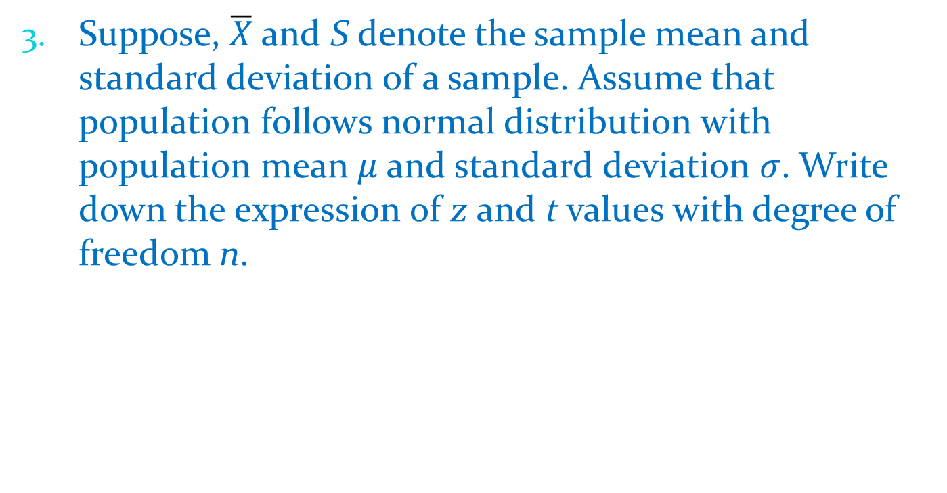
Questions of the day…
Suppose, $\overline{X}$and S denote the sample mean and standard deviation of a sample. Assume that population follows normal distribution with population mean $μ$ and standard deviation $σ$. Write down the expression of z and t values with degree of freedom n.

